Slide 1

Application Layer Protocols
and
Services -1
Delivered By:
Avinash Bhagat
9463281930
avinash.bhagat@lpu.co.in
Copyright © The McGraw-Hill Companies, Inc. Permission required for reproduction or display.

Slide 2
Domain Name System (DNS) Chapter 25
TELNET Chapter 26
Simple Mail Transfer Protocol and Post Office Protocol Chapter 26
File Transfer Protocol Chapter 26
World Wide Web www Chapter27
Hyper text transfer Protocol HTTP Chapter27
Terminologies in Network Security Chapter30
Firewalls Chapter32
Virtual Private Network (VPN) Chapter32

Slide 3
The application layer is responsible for providing services to the user. e.g.
client/server pair in the Internet.
remote login, electronic mail, and file transfer.
world wide web (WWW)
HTTP that is commonly used to access the web.

Slide 4
Programs that can be directly used by the user, such as e-mail.
Programs that support other application programs. The Domain Name System (DNS) is a supporting program that is used by other programs such as e-mail.

Slide 5

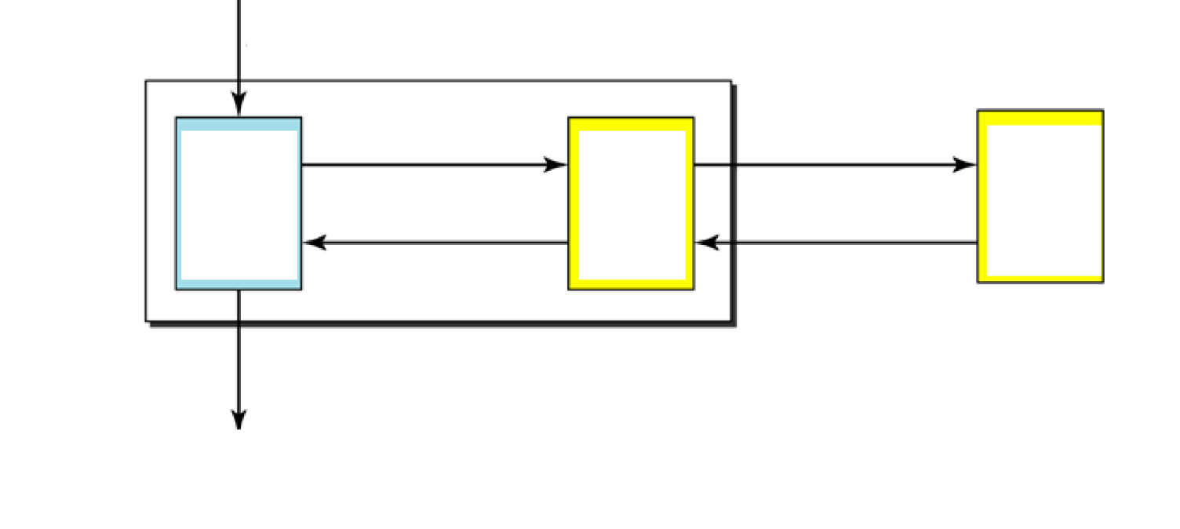
https://www.youtube.com/watch?v=mpQZVYPuDGU

Slide 6
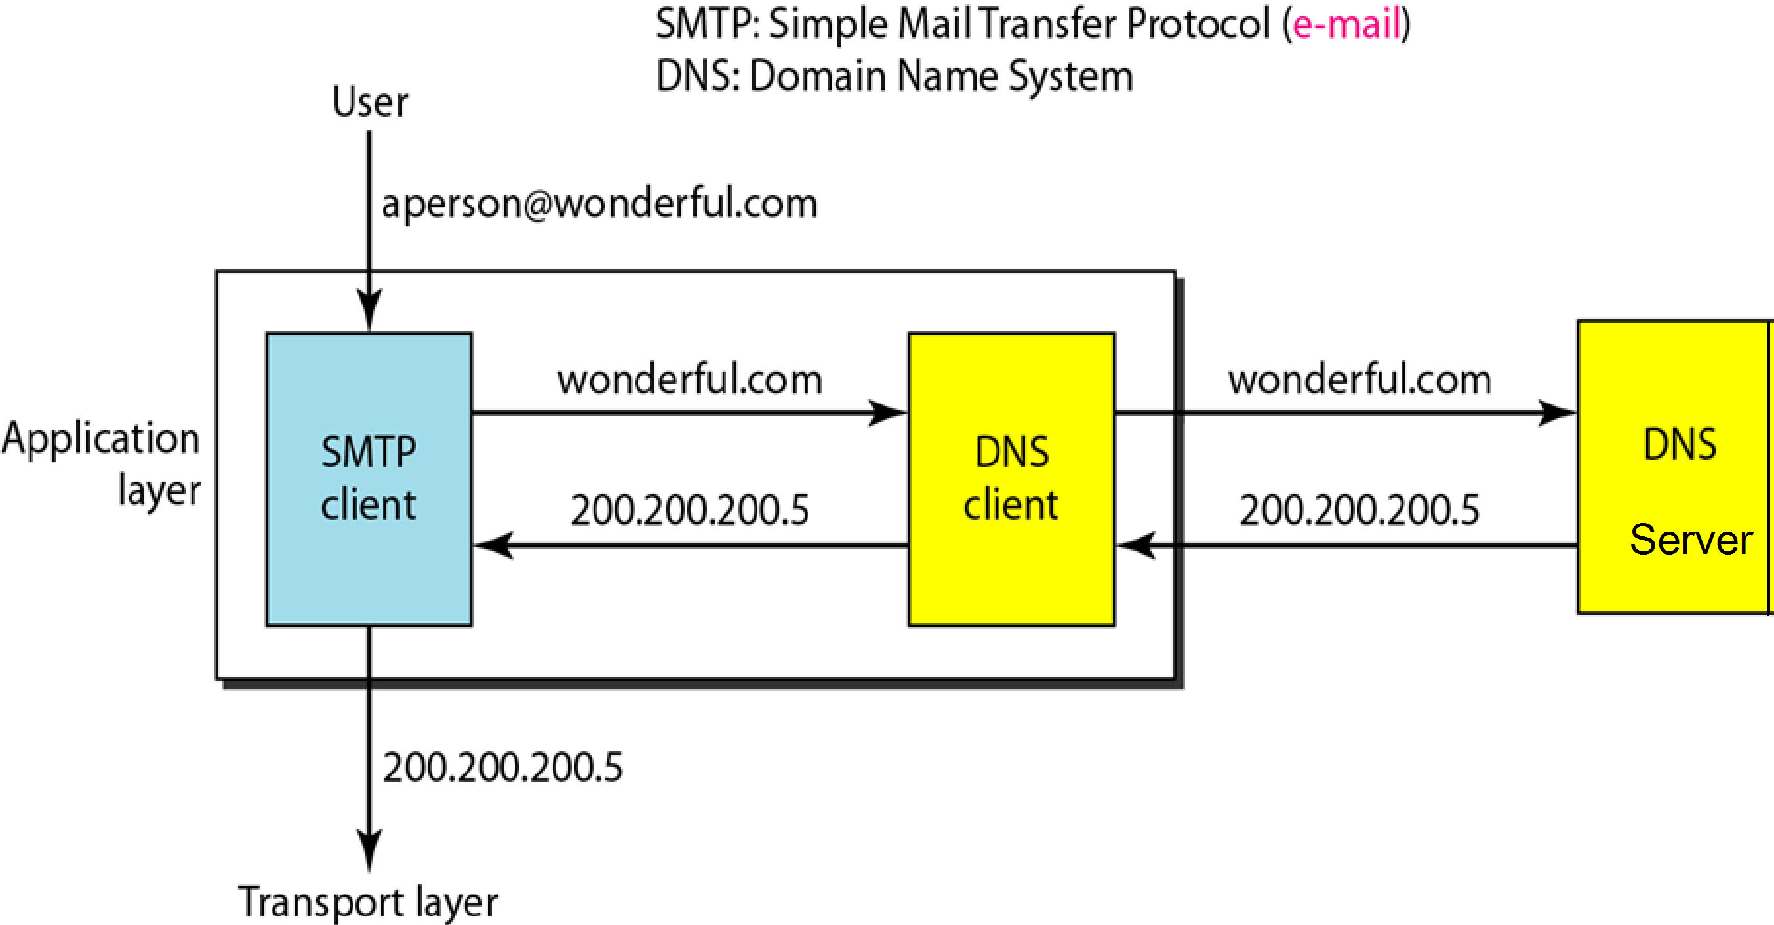

Slide 7
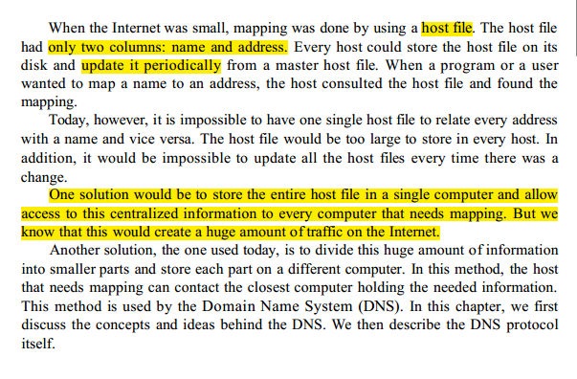

Slide 8
25-1 NAME SPACE
To be unambiguous, the names assigned to machines must be carefully selected from a name space with complete control over the binding between the names and IP addresses.
Flat Name Space: In a flat name space, a name is assigned to an address. A name in this space is a sequence of characters without structure.
Hierarchical Name Space: In a hierarchical name space, each name is made of several parts. The first part can define the nature of the organization, the second part can define the name of an organization, the third part can define departments in the organization, and so on.

Slide 9
25-1 NAME SPACE
Flat Name Space: In a flat name space, a name is assigned to an address. A name in this space is a sequence of characters without structure. The main disadvantage of a fiat name space is
that it cannot be used in a large system such as the Internet because it must be centrally controlled to avoid ambiguity and duplication

Slide 10
25-1 NAME SPACE
Hierarchical Name Space: In a hierarchical name space, each name is made of several parts.
The nature of the organization,
Name of an organization,
Departments in the organization,

Slide 11
25-2 DOMAIN NAME SPACE
To have a hierarchical name space, a domain name space was designed. In this design the names are defined in an inverted-tree structure with the root at the top. The tree can have only 128 levels: level 0 (root) to level 127.

Slide 12

Domain Name Space

Slide 13
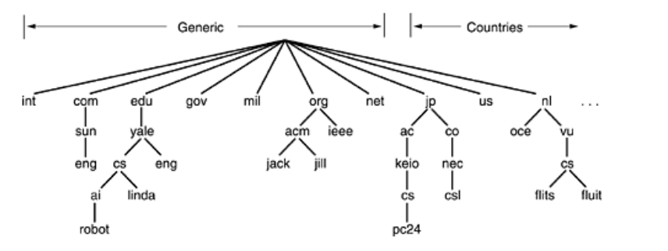
the Internet is divided into over 200 top-level domains, where each domain covers many hosts.

Slide 14
The top-level domains come in two flavors:
generic and countries.
The original generic domains were
com (commercial),
edu (educational institutions),
gov (the U.S. Federal Government),
int (certain international organizations),
mil (the U.S. armed forces),
net (network providers),
and org (nonprofit organizations).

Slide 15
In November 2000, ICANN approved four new, general-purpose, top- level domains, namely,
biz (businesses),
info (information),
name (people's names),
and pro (professions, such as doctors and lawyers).

Slide 16
In addition, three more specialized top-level domains were introduced at the request of certain industries.
These are aero (aerospace industry),
coop (co-operatives),
and museum (museums).

Slide 17
Label:
Each node in the tree has a label, which is a string with a maximum of 63 characters.
The root label is a null string (empty string).
DNS requires that children of a node have different labels, which guarantees the uniqueness of the domain names.
Domain Name:
Each node in the tree has a domain name.
A full domain name is a sequence of labels separated by dots (.).
The domain names are always read from the node up to the root.
The last label is the label of the root (null).
This means that a full domain name always ends in a null label, which means the last character is a dot because the null string is nothing.

Slide 18
http://www.thelongestdomainnameintheworldandthensomeandthensomemoreandmore.com/

Slide 19

Figure 25.3 Domain names and labels

Slide 20

Table 25.1 Generic domain labels
25.<number>

Slide 21

Note
DNS can use the services of UDP or TCP using the well-known port 53.
25.<number>

Slide 22
Subjective Questions
Write a note on DNS
Write a note on Domain name space.

Slide 23
Multiple Choice Questions
In a _______ name space, a name is assigned to an address. A name in this space is a sequence of characters without structure.
a. flat
b. hierarchical
c. organized
d. none of the above

Slide 24
Multiple Choice Questions
In a _______ name space, a name is assigned to an address. A name in this space is a sequence of characters without structure.
a. flat
b. hierarchical
c. organized
d. none of the above

Slide 25
Multiple Choice Questions
In a _________name space, each name is made of several parts.
a. flat
b. hierarchical
c. organized
d. none of the above

Slide 26
Multiple Choice Questions
In a _________name space, each name is made of several parts.
a. flat
b. hierarchical
c. organized
d. none of the above

Slide 27
Multiple Choice Questions
In the DNS, the names are defined in ___________ structure.
a. a linear list
b. an inverted-tree
c. a graph
d. none of the above

Slide 28
Multiple Choice Questions
In the DNS, the names are defined in ___________ structure.
a. a linear list
b. an inverted-tree
c. a graph
d. none of the above

Slide 29
Multiple Choice Questions
Each node in the tree has a _______, which is a string with a maximum of ___ characters.
a. label; 127
b. name; 255
c. label; 63
d. none of the above

Slide 30
Multiple Choice Questions
Each node in the tree has a _______, which is a string with a maximum of ___ characters.
a. label; 127
b. name; 255
c. label; 63
d. none of the above

Slide 31
Multiple Choice Questions
The root of the DNS tree is _______.
a. a string of characters
b. a string of 63 characters
c. an empty string
d. none of the above

Slide 32
Multiple Choice Questions
The root of the DNS tree is _______.
a. a string of characters
b. a string of 63 characters
c. an empty string
d. none of the above

Slide 33
Multiple Choice Questions
A full domain name is a sequence of labels separated by ________.
a. semicolons
b. dots
c. colons
d. none of the above

Slide 34
Multiple Choice Questions
A full domain name is a sequence of labels separated by ________.
a. semicolons
b. dots
c. colons
d. none of the above

Slide 35
Multiple Choice Questions
A _________ is a subtree of the domain name space.
a. label
b. name
c. domain
d. none of the above

Slide 36
Multiple Choice Questions
A _________ is a subtree of the domain name space.
a. label
b. name
c. domain
d. none of the above

Slide 37
Multiple Choice Questions
In the domain name chal.atc.fhda.edu, _______ is the least specific label.
a. chal
b. atc
c. edu
d. none of the above

Slide 38
Multiple Choice Questions
In the domain name chal.atc.fhda.edu, _______ is the least specific label.
a. chal
b. atc
c. edu
d. none of the above

Slide 39
Multiple Choice Questions
In the domain name chal.atc.fhda.edu, _______ is the most specific label.
a. chal
b. atc
c. fhda
d. none of the above

Slide 40
Multiple Choice Questions
In the domain name chal.atc.fhda.edu, _______ is the most specific label.
a. chal
b. atc
c. fhda
d. none of the above

Slide 41
Multiple Choice Questions
A host with the domain name pit.arc.nasa.gov. is on the _______ level of the DNS hierarchical tree. (The root is level one.)
a. third
b. fourth
c. fifth
d. none of the above

Slide 42
Multiple Choice Questions
A host with the domain name pit.arc.nasa.gov. is on the _______ level of the DNS hierarchical tree. (The root is level one.)
a. third
b. fourth
c. fifth
d. none of the above

